Slide 1

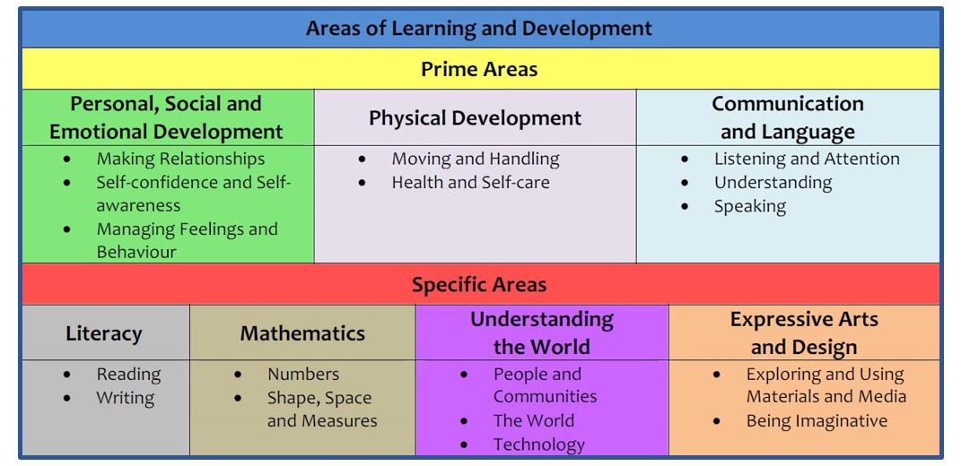
Reception Long
Term Plan
At St. Peter’s, we plan for a variety of activities and experiences for the children to develop and build on their skills and knowledge throughout the year, through explicit teaching and explorative play.
St. Peter’s is a caring Christian community, where we LOVE, LEARN and AIM HIGH.
At St. Peter’s CE Primary School, the EYFS curriculum is designed to build upon children’s prior learning. Our curriculum is child centred at its heart, recognising that each child is an individual and comes to school with a wealth of knowledge and cultural experiences. We get to know each individual child and their interests so the learning opportunities that we provide are motivating and inclusive.

Slide 2
Reception Long Term Plan: Cycle A
 | Autumn 1 | Autumn 2 |  | Spring 1 | Spring 2 | Summer 1 | Summer 2
KS1 Topics | Toys |  |  | Exploring Africa |  | Castles and Kingdoms
General Themes NB: These themes may be adapted at various points to allow for children’s interests to flow through the provision | All about me Starting school / my new class / New Beginnings Our senses Staying healthy / Teeth/Food / Human body My family What am I good at? How do I make others feel? Being kind / staying safe Where do we live? |  | celebrations Changes in Autumn Harvest Festival Birthdays The Nativity Christmas Lists | Discoverers Maps Continents Oceans Seaside Creation Environment/Pollution/ Recycling. | Growing Plants & Flowers Gardening/Planting Jack and The Beanstalk Spring – Seasons. Easter | Once upon a time Traditional Tales Fairy Tales Castles Transport and travelling | All Creatures Great and small God’s creatures Noah’s Ark. Farm animals Minibeasts Caring for our world
Key Texts DRAWING CLUB: | Colour Monster/Elmer Once there were Giants Each Peach Pear Plum by Janet and Allen Ahlberg Hairy Maclary by lynley Dodd Noah’s Ark Colour Monster Rabbit Foo Foo Night Pirates BananaMan Super Worm Not Now Bernard |  | Kippers Birthday The Nativity Hug by Jez Alborough Where’s Spot? By Eric Hill Bonfire Night Poem Binny’s Diwali The Way Back Home Owl Babies Wow Said the Owl The Little Christmas Tree Dear Santa Leaf Man | Tiddler Snail and the Whale The train ride by June Crebbin How to Catch a Star Stuck Rainbow Fish | Jaspers Beanstalk The Tiny Seed Oliver’s Garden The Easter Story Come on, Daisy by Jane Simmons Rosie’s Walk Would you Rather? Jack and The Beanstalk Chicken Licken Wacky Races | Little Red Rapunzel In the Castle You Choose A little Bit Brave The Hairy Toe Room on The Broom The three Little Pigs Goldilocks Red Riding Hood | The Very Hungry Caterpillar. We’re going on a bear hunt by Michael Rosen Brown Bear by Eric Carle My Brother Are the Dinosaurs Dead, Dad? Dear Zoo by Rod Campbell
Enrichments | Remembrance Day Harvest Time Rhyme Time |  | Guy Fawkes / Bonfire Night Nativity Diwali Walk to Post Office | Chinese New Year Shrove Tuesday Ash Wednesday/ LENT Farm trip- new born lambs | Planting seeds Easter time Mother’s Day FOREST SCHOOL |  | Father’s Day Sport’s Day
Narrative 1 | What is ambition? |  |  | How do values help us to learn? |  | What is our community?

Slide 3
Reception Long Term Plan: Cycle B
 | Autumn 1 | Autumn 2 | Spring 1 | Spring 2 | Summer 1 | Summer 2
KS1 TOPICS | Fire and Ice |  | Once upon a Time |  | Ocean Rescue
General Themes NB: These themes may be adapted at various points to allow for children’s interests to flow through the provision | All about me Starting school / my new class / New Beginnings Our senses Staying healthy / Teeth/Food / Human body My family What am I good at? How do I make others feel? Being kind / staying safe Where do we live? | celebrations Changes in Autumn Harvest Festival Birthdays The Nativity Christmas Lists | Once upon a time Traditional Tales Fairy Tales Castles Transport and travelling | Growing Plants & Flowers Gardening/Planting Jack and The Beanstalk Spring – Seasons. Easter | Discoverers Maps Continents Oceans Seaside Creation Environment/Pollution/Recycling. | All Creatures Great and small God’s creatures Noah’s Ark. Farm animals Minibeasts Caring for our world
Key Texts DRAWING CLUB: | Colour Monster/Elmer Once there were Giants Each Peach Pear Plum by Janet and Allen Ahlberg Hairy Maclary by lynley Dodd Colour Monster Rabbit Foo Foo Night Pirates BananaMan Super Worm Not Now Bernard | Kippers Birthday The Nativity Hug by Jez Alborough Where’s Spot? By Eric Hill Bonfire Night Poem Binny’s Diwali The Way Back Home Owl Babies Wow Said the Owl The Little Christmas Tree Dear Santa Leaf Man | Little Red Rapunzel In the Castle You chose A little Bit Brave The Hairy Toe Room on The Broom The three Little Pigs Goldilocks Red Riding Hood | Jaspers Beanstalk The Tiny Seed Oliver’s Garden The Easter Story Come on, Daisy by Jane Simmons Rosie’s Walk Would you Rather? Jack and The Beanstalk Chicken Licken Wacky Races | Tiddler Snail and the Whale The train ride by June Crebbin How to Catch a Star Stuck Rainbow Fish | The Very Hungry Caterpillar. We’re going on a bear hunt by Michael Rosen Brown Bear by Eric Carle My Brother Are the Dinosaurs Dead, Dad? Dear Zoo by Rod Campbell
Enrichments | Remembrance Day Harvest Time Favourite Songs Fire & Rescue Service | Guy Fawkes / Bonfire Night Nativity Diwali Walk to Post Office – | Chinese New Year Shrove Tuesday Ash Wednesday/ LENT Farm trip- new born lambs | Planting seeds Easter time Mother’s Day FOREST SCHOOL | RNLI visitor? | Father’s Day Sport’s Day
Narrative | What is ambition? |  | How do values help us to learn? |  | What is our community?

Slide 4

Reception Long Term Plan
 | Autumn 1 | Autumn 2 |  | Spring 1 |  | Spring 2 |  | Summer 1 |  | Summer 2
General Themes | All about me | celebrations |  | Once upon a time |  | Growing |  | Discoverers |  | All Creatures Great and small
Communication and Language | The development of children’s spoken language underpins all seven areas of learning and development. Children’s back-and-forth interactions from an early age form the foundations for language and cognitive development. The number and quality of the conversations they have with adults and peers throughout the day in a language-rich environment is crucial. By commenting on what children are interested in or doing, and echoing back what they say with new vocabulary added, practitioners will build children's language effectively. Reading frequently to children, and engaging them actively in stories, non-fiction, rhymes and poems, and then providing them with extensive opportunities to use and embed new words in a range of contexts, will give children the opportunity to thrive. New story-related vocabulary is introduced weekly through Drawing Club, which is then practiced daily alongside topic-related vocabulary.
Planned Opportunities to develop language throughout the year include: | Transitional Mouse Marvelous Me boxes Settling in activities Making friends PHASE 1 Activities Rhyming and alliteration Model talk routines through the day. For example, arriving in school: “Good morning, how are you?” Sing familiar songs and rhymes |  | Theme/Subject related new vocabulary Drawing Club story vocabulary daily Weekly Drawing Club story Sing familiar songs and rhymes Nativity Play Christmas Service Learning Nativity songs |  | Theme/Subject related new vocabulary Drawing Club story vocabulary daily Sing familiar songs and rhymes Traditional and Fairy Tales |  | Theme/Subject related new vocabulary Drawing Club story vocabulary daily Sing familiar songs and rhymes Vocabulary and conversations around plants, trees, farming, growing, taking care of our environment. |  | Theme/Subject related new vocabulary Drawing Club story vocabulary daily Sing familiar songs and rhymes Vocabulary around oceans, seas, travelling, journeys, other countries and cultures. |  | Theme/Subject related new vocabulary Drawing Club story vocabulary daily Sing familiar songs and rhymes Vocabulary around mini-beasts, animals, being healthy, sunshine safety.
Development Matters and ELG checkpoints: | To understand why listening is important. Enjoy listening to longer stories and remember what happens To be able to follow instructions/directions Understand how to listen carefully. To talk in front of a small group. Develop communication, with some problems with tense To learn new vocabulary linked to the themes learning To talk to their teacher and other supporting adults |  |  |  | To ask questions to find out more. To retell a story. To develop confidence to talk to other adults at school. To talk in sentences using a conjunction e.g. and or because. To use new vocabulary in a range of contexts. |  |  |  | To understand questions such as who, what, where, when, why and how. To have conversations with adults and peers with back and forth interactions. To use talk to organise, sequence and clarify their thinking, ideas, feelings and events.

Slide 5

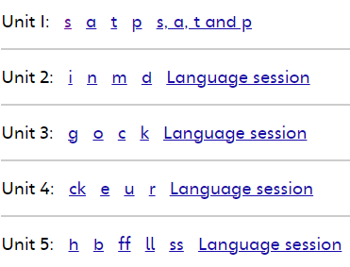
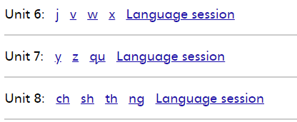
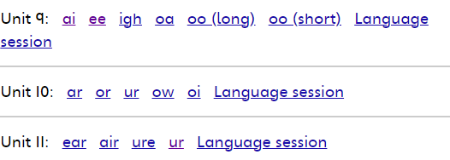

Reception Long Term Plan
 | Autumn 1 | Autumn 2 | Spring 1 | Spring 2 | Summer 1 |  | Summer 2
General Themes | All about me | celebrations | Once upon a time | growing | discoverers |  | All creatures great and small
Literacy Firm foundations: | AWARENESS OF AUDIENCE: Participate in small group, class and one-to-one discussion, offering their own ideas, using recently introduced vocabulary. Offer explanations for why things might happen, making use of recently introduced vocabulary from stories, non-fiction, rhymes and poems when appropriate. Express their ideas and feelings about their experiences using full sentences, including use of past, present and future tenses and making use of conjunctions, with modelling and support from their teacher PHONICS AND SPELLING RULES: Say a sound for each letter in the alphabet and at least 10 digraphs. • Read words consistent with their phonic knowledge by sound-blending. • Read aloud simple sentences and books that are consistent with their phonic knowledge, including some common exception words. COMMON EXCEPTION WORDS: To write some irregular common words.
Comprehension Key Texts through drawing club conversations | Colour Monster Rabbit Foo Foo Night Pirates BananaMan Super Worm Not Now Bernard | Bonfire Night Poem Binny’s Diwali The Way Back Home Owl Babies Wow Said the Owl The Little Christmas Tree Dear Santa Leaf Man | A little Bit Brave The Hairy Toe Room on The Broom The three Little Pigs Red Riding Hood You Choose | Rosie’s Walk Would you Rather? Jack and The Beanstalk Chicken Licken Wacky Races | How To Catch a Star Tiddler Stuck Rainbow Fish Snail and the Whale | My Brother Are the Dinosaurs Dead, Dad? The Odd Egg Dear Zoo The Hungry Caterpilar
Comprehension Development Matters and ELG checkpoints: | * Listen to a Story and comment on events. DM 3-4 Name the characters from a familiar setting. DM 3-4 *Identify Characters and setting of a familiar book * Join in with repeated refrain from a familiar story *Begin to use language from story when discussing it |  | *Sequence a familiar story using images or objects * make simple predictions based on events of a story *use language from a story in role play |  | *Demonstrate understanding of what has been read to them by telling stories using their own words *Anticipate key events in stories *use and understand recently introduced vocabulary during discussions and role play
Word Reading Bug Club Phonics
Word Reading Development Matters and ELG checkpoints | *Identify an object when initial sound given DM 3-4 *Say the initial sound in a given word. DM 3-4 *Clap syllables in a word. DM 3-4 *Say a sound for all phase 2 GPCS *Blend all CVC words verbally |  | *Say all phase 2 and 3 single GPCs *Blend vc/cvc words *Say a sound for each letter in the alphabet and at least 10 digraphs. |  | *Say a sound for ALL phase 3 digraphs and trigraphs. Read words consistent with their phonic knowledge by blending. *Read phase 3 tricky words by sight. *Read words using consonant blends.

Slide 6
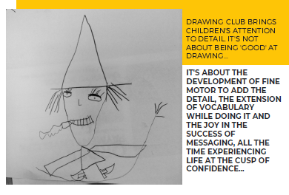

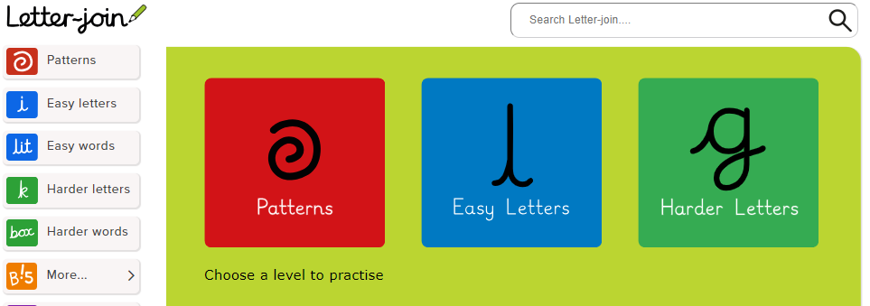

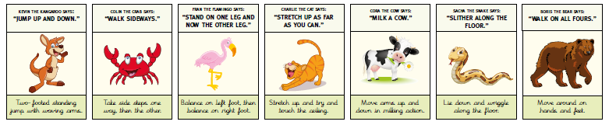


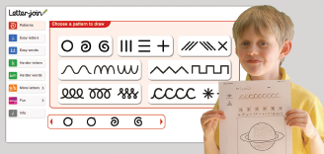

Reception Long Term Plan
 | Autumn 1 | Autumn 2 | Spring 1 | Spring 2 | Summer 1 | Summer 2
General Themes | All about me | celebrations | Once upon a time | growing | discoverers | All creatures great and small
Writing Firm foundations: | Early Writing is developed throughout the year using DRAWING CLUB and LETTERJOIN (which supports PD through gross and fine motor skills development) LETTER FORMATION: Hold a pencil effectively in preparation for fluent writing – using the tripod grip in almost all cases. Write recognisable letters, most of which are correctly formed PLANNING, WRITING AND EDITING: Write simple phrases and sentences that can be read by others. Invent, adapt and recount narratives and stories with peers and teachers.
Writing Key texts . | Texts as a Stimulus: Colour Monster/Elmer Once there were Giants Each Peach Pear Plum by Janet and Allen Ahlberg Hairy Maclary by lynley Dodd Noah’s Ark Colour Monster Rabbit Foo Foo Night Pirates BananaMan Super Worm Red Hen | Texts as a Stimulus: Kippers Birthday The Nativity Hug by Jez Alborough Where’s Spot? By Eric Hill Exploring Fireworks (CLL FOCUS) Exploring Diwali (CLL/KUW Focus) The Way Back Home Owl Babies Wow Said the Owl The Little Christmas Tree Dear Santa | Texts as a Stimulus: –Michael Recycle Snail and the Whale Tadpole’s Promise I am a Frog The train ride by June Crebbin You Choose Lost and Found Tiddler Stuck Captain Pugwash .. | Texts as a Stimulus: Jaspers Beanstalk The Tiny Seed Oliver’s Garden The Easter Story Come on, Daisy by Jane simmons Rosie’s Walk Would you Rather? Jack and The Beanstalk Chicken Licken Wacky Races | Texts as a Stimulus: Little Red Rapunzel In the Castle Not Now Bernard Room on The Broom The three Little Pigs Dear Zoo by Rod Campbell | Texts as a Stimulus: AHHH Spider! The Very Hungry Caterpillar. We’re going on a bear hunt by Michael Rosen Brown Bear by Eric Carle My Brother Are the Dinosaurs Dead, Dad? The Odd Egg Mr Ben: Zookepper .

Slide 7

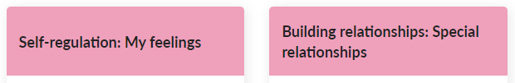



Reception Long Term Plan
 | Autumn 1 | Autumn 2 | Spring 1 | Spring 2 | Summer 1 | Summer 2
General Themes | All about me | celebrations | Once upon a time | Growing | Discoverers | All Creatures Great and small
Personal, Social and Emotional Development | Children’s personal, social and emotional development (PSED) is crucial for children to lead healthy and happy lives, and is fundamental to their cognitive development. Underpinning their personal development are the important attachments that shape their social world. Strong, warm and supportive relationships with adults enable children to learn how to understand their own feelings and those of others. Children should be supported to manage emotions, develop a positive sense of self, set themselves simple goals, have confidence in their own abilities, to persist and wait for what they want and direct attention as necessary. Through adult modelling and guidance, they will learn how to look after their bodies, including healthy eating, and manage personal needs independently. Through supported interaction with other children, they learn how to make good friendships, co-operate and resolve conflicts peaceably. These attributes will provide a secure platform from which children can achieve at school and in later life. Weekly planning using the Enhancements below link to the KS1 KAPOW RHE SOL, and prepares them with the prerequisites to develop the concepts of : Family and Relationships, Health and Wellbeing, Safety and the Changing Body, Citizenship, Economic Well-being.
Planned Opportunities to develop PSED skills throughout the year include: Linked to Christian values- behavior for learning | Christian values: focus on respect Respecting toys, each other, working together, sharing, kindness, regulating our feelings Marvellous Me box Transition Mouse Class Routines and hygiene Colour Monster emotional regulation How to use the calm corner- emotional regulation High Five- social strategies |  | Christian Values: focus on creativity and perseverance Trying new foods, trying new and challenging activities, persevering at something that is challenging, demonstrating resilience, creative ideas to solve problems, creative ways of practising our learning skills. Forest School Cooking Club |  | Christian Values: focus on reflection and courage _ Trying swimming and having courage to develop water confidence, courage to try new activities in sports day, reflecting on our learning skills and how we can make choices to develop those through our play and discovery time, reflecting on our choices, reflecting to help us learn from our mistakes, reflecting on how we can work together as a community to help each other flourish as well as flourishing as an individual. Sports Day Reception team games
Kapow EYFS concept coverage
Development Matters and ELG checkpoints: | Development Matters 3-4 |  | Development Matters Children in reception |  | ELGS

Slide 8

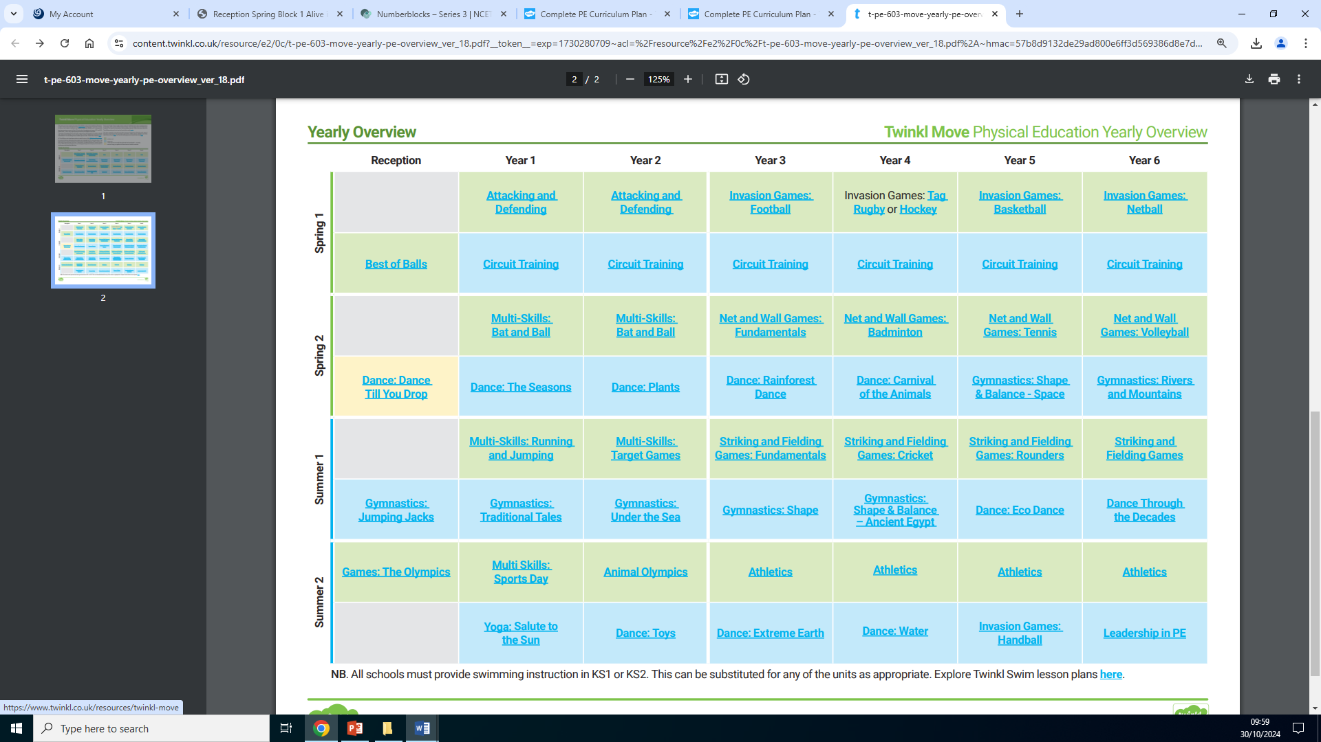
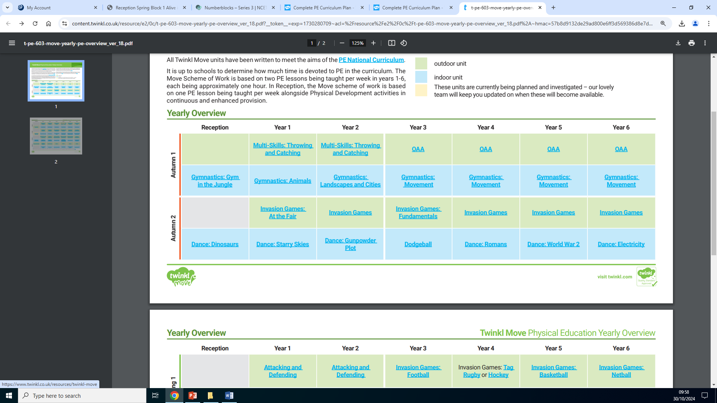
Reception Long Term Plan
 | Autumn 1 | Autumn 2 | Spring 1 | Spring 2 | Summer 1 | Summer 2
General Themes | All about me | Celebrations | Once upon a time | Growing | Discoverers | All creatures great and small
Physical development Weekly PE Sessions using Twinkl Planning that creates foundations for Ks1 in line with the whole-school wider curriculum
Fine motor Planned Opportunities to develop PSED skills throughout the year include (opportunities to practice these daily) | Daily Dough disco Daily ‘Squiggle Club’ Letter Join finger strength and patterns activities Funky finger morning activities. Threading, cutting, weaving, playdough, Fine Motor activities. Begin to form letters correctly Handle tools, objects, construction and malleable materials with increasing control Encourage children to draw freely. Holding Small Items / Button Clothing / Cutting with Scissors |  | Letter Join: Daily letter formation and finger strength activities Funky finger morning activities. Threading, cutting, weaving, playdough, Fine Motor activities. Begin to form letters correctly Handle tools, objects, construction and malleable materials with increasing control Encourage children to draw freely. Using cuterly for cooking skills Holding Small Items / Button Clothing / Cutting with Scissors |  | Letter join Cursive writing plans Playdough Small part play Collage/ art activities Sewing/using tools effectively
Gross motor Planned Opportunities to develop PSED skills throughout the year include: | Letter Join gross motor Skill development plans Dance Different ways of moving to be explored with children Forest School Sessions Ball skills- throwing and catching. blocks and tyres for creating balancing equipment Remember and copy motions in time to music (Nativity dances) |  | Letter Join gross motor Skill development plans Ball skills- aiming, dribbling, pushing, throwing & catching, patting, or kicking Gymnastics ./ Balance Navigating the Forest School environment safely Balance- children moving with confidence |  | Go Noodle Gross motor guided dance/strength building activities Letter Join gross motor Skill development plans Obstacle activities Swimming Races / team games involving gross motor movements dance related activities
Development Matters and ELG checkpoints: | Development Matters 3-4 |  | Development Matters Children in reception |  | ELGS

Slide 9

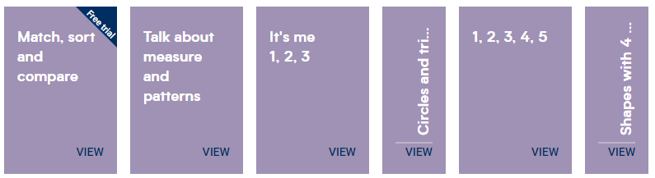
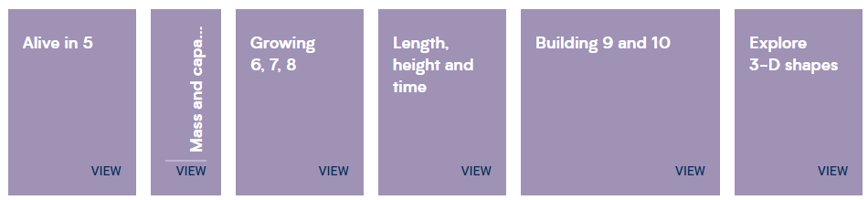
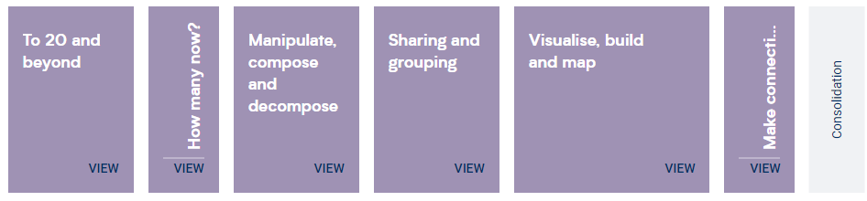


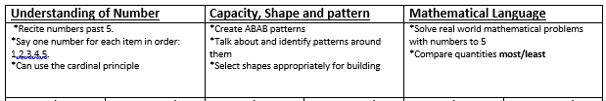
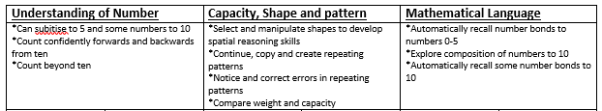
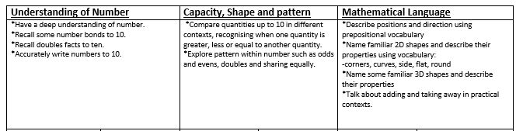

Reception Long Term Plan
 | Autumn 1 | Autumn 2 | Spring 1 | Spring 2 | Summer 1 | Summer 2
 | All about me | celebrations | Once upon a time | growing | discoverers | All creatures great and small
Maths | Developing a strong grounding in number is essential so that all children develop the necessary building blocks to excel mathematically. Children should be able to count confidently, develop a deep understanding of the numbers to 10, the relationships between them and the patterns within those numbers. By providing frequent and varied opportunities to build and apply this understanding - such as using manipulatives, including small pebbles and tens frames for organising counting - children will develop a secure base of knowledge and vocabulary from which mastery of mathematics is built. In addition, it is important that the curriculum includes rich opportunities for children to develop their spatial reasoning skills across all areas of mathematics including shape, space and measures. It is important that children develop positive attitudes and interests in mathematics, look for patterns and relationships, spot connections, ‘have a go’, talk to adults and peers about what they notice and not be afraid to make mistakes.
Mathematical development throughout the year is planned using the Whiterose SOL and enhancements from the NCETM
Development Matters and ELG checkpoints:

Slide 10

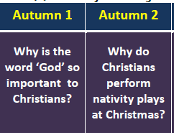
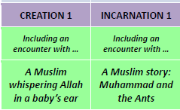
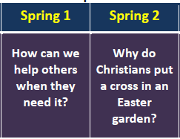
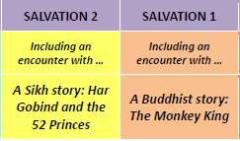
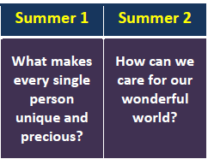
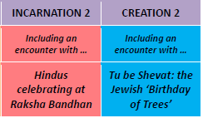
Reception Long Term Plan
 | Autumn 1 | Autumn 2 |  | Spring 1 | Spring 2 |  | Summer 1 | Summer 2
General Themes | All about me | celebrations |  | Once upon a time | growing |  | discoverers | All creatures great and small
Understanding the world | Understanding the world involves guiding children to make sense of their physical world and their community. The frequency and range of children’s personal experiences increases their knowledge and sense of the world around them – from visiting parks, libraries and museums to meeting important members of society such as police officers, nurses and firefighters. In addition, listening to a broad selection of stories, non-fiction, rhymes and poems will foster their understanding of our culturally, socially, technologically and ecologically diverse world. As well as building important knowledge, this extends their familiarity with words that support understanding across domains. Enriching and widening children’s vocabulary will support later reading comprehension.
Planned Opportunities to develop UtW skills throughout the year include: | Marvellous Me boxes: Identifying their family. Commenting on photos of their family; naming who they can see and of what relation they are to them. Looking at old toys, to make comparisons with toys we have now and encourage conversations with parents and grandparents about their favourite toys. Compare and identify How we have changed over time from a baby to school age- looking at baby photos |  | Can talk about changes they observe in the seasons. Can make observations of the natural world – Autumn woodland walk, collecting natural resources. Recognise that people have different beliefs and celebrate special times in different ways. Other worldviews/ faiths explored through the Kapow Music Unit ‘Celebration Music’ | Farm visit Make observations, sketches of natural world including animals. Explore maps of the school, village and of fairy tale settings. Take children to places of worship and places of local importance to the community. compare celebrations, role play, watch dragon/lion dances. | Grow beans and other plants. Learn what is needed to look after them. Make observations. Change in living things – Changes in the leaves, weather, seasons, Explore the world around us at Forest School, drawing pictures of plants/minibeasts that live there. Draw children’s attention to the immediate environment, introducing and modelling new vocabulary where appropriate. | Know about people from the past Environments – Features of local environment, vehicle survey, bus routes. Maps of local area Comparing places on Google Earth – how are they similar/different? Use images, video clips, shared texts and other resources to bring the wider world into the classroom. Listen to what children say about what they see Recognise some similarities and differences between life in this country and life in other countries. Share non-fiction texts that offer an insight into contrasting environments. |  |  | Listen to how children communicate their understanding of their own environment and contrasting environments through conversation and in play. Can children differentiate between land and water on the globe. Draw maps of local areas, treasure maps or maps from familiar stories such as ‘We’re Going on a Bear Hunt’ Observe and discuss life processes using stories such as the ‘Hungry Caterpillar’
Past & Present | Development Matters 3-4 |  |  | Development Matters Children in Reception |  | ELGS
People, culture & communities
The natural world | Development Matters 3-4 |  |  | Development Matters Children in Reception |  | ELGS

Slide 11








Reception Long Term Plan
 | Autumn 1 | Autumn 2 | Spring 1 | Spring 2 | Summer 1 | Summer 2
General Themes | All about me | celebrations | Once upon a time | Growing | discoverers | All creatures great and small
Expressive Arts and Design . Planned Opportunities to develop EAD skills throughout the year include: (Junk modelling, art equipment, small world and role-play are accessible daily through Discovery Time) | The development of children’s artistic and cultural awareness supports their imagination and creativity. It is important that children have regular opportunities to engage with the arts, enabling them to explore and play with a wide range of media and materials. The quality and variety of what children see, hear and participate in is crucial for developing their understanding, self-expression, vocabulary and ability to communicate through the arts. The frequency, repetition and depth of their experiences are fundamental to their progress in interpreting and appreciating what they hear, respond to and observe. Give children an insight into new musical worlds. Invite musicians in to play music to children and talk about it. Encourage children to listen attentively to music. Discuss changes and patterns as a piece of music develops.
Expressive Arts and Design Painting, 3D modelling, messy play, collage, cutting, drama, role play, threading, moving to music, clay sculptures, following music patterns with instruments, singing songs linked to topics, making instruments, percussion. Children to produce a piece of art work each half term to be displayed for ‘Celebration wall’ for school / parents to show how drawings have developed - lots of links to Fine Motor Skills. Children to explain their work to others. Children will have opportunities to learn and perform songs, nursery rhymes and poetry linked to their work / interests and passions. | Opportunities for Rhyme Time and singing familiar songs. Drawing Club: Mark making Letterjoin: Creating patterns Colours, shape and printing (link to KS1 Joan Miro) | Christmas Songs and the Nativity play Parties pretend play Firework paintings to music Diwa lamps Seasons pictures- printing | Collage 3 little pigs houses Make a cape for Red-Riding Hood Making Porridge | Drawing seeds, bulbs, plants, trees Paper tube art Seasons pictures- collage Collaborative art- the Giant’s castle (jack and the Beanstalk) | Observational painting using colour mixing- Handa’s Surprise fruit Collage artic sea picture using tearing techniques Wax resist art | Eric Carle- Exploring collage and colour through The Very Hungry Caterpillar & Brown Bear Brown Bear Seasons pictures- printing Making fruit smoothies
Small world and role play areas in CP to be developed each half term. | Home Corner | Party House | Castle/Red Riding Hood’s Cottage | Garden Centre | African Safari/ Artic explorers | Vets
Development Matters and ELG checkpoints ART: | Development Matters 3-4 |  | Development Matters Children in Reception |  | ELGS
Music from KAPOW:

