Slide 1
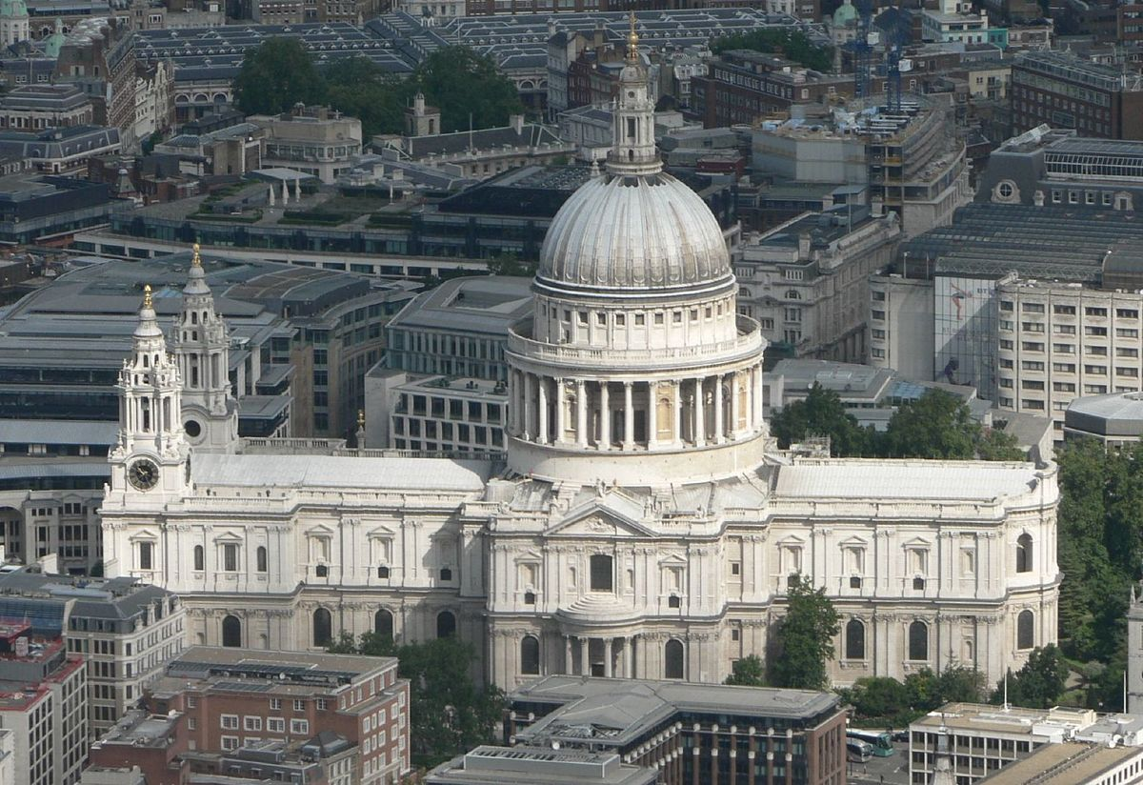
Welcome to Year 6
St Paul’s Class
Class Teacher: Mr Ritchie
HLTA: Mrs Hole

Slide 2
Staff in the Class:
Mr Ritchie: Class Teacher
Mrs Hole: HLTA
Mrs Crellin: French

Slide 3
There’s more to Year 6 than SATs!
Successful and Enthusiastic Learners
Confident Individuals
Responsible Citizens

Slide 4
…having said that…
Mathematics
English
Paper1 - Arithmetic
EGPS
Reading
Paper 2 – Problem solving and reasoning
Paper 3 – Problem solving and reasoning

Slide 5
Routines of the Year Group
Indoor P.E. day is Monday. Outdoor games day is Thursday.
Water bottles are welcome and encouraged.
Homework is given out on Friday and due in Wednesday (this will begin after the residential trip).

Slide 6
Homework
Year 6 homework will consist of…
1 x Written Maths
1 x Written English/Topic/Grammar
1 x Mental Maths (times tables)
1 x Spelling words to learn
Lots of reading…please!

Slide 7
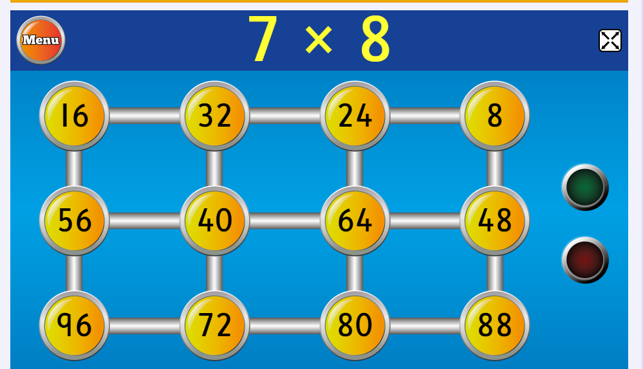
How to help your child…
Times Tables
Hit the Button – www.topmarks.co.uk/maths-games/hit-the-button

Slide 8
How to help your child…
Times Tables
*Children have their individual logins*

Slide 9
How to help your child…
Times Tables

Slide 10
Our Topic: We’ll Meet Again
The Blitz
The Homefront
The Battle of Britain
The Holocaust
Remembrance

Slide 11
Fluency and conceptual understanding
Reasoning and Problem Solving
Number
Compare numbers up to 10,000,000
Solve problems involving negative numbers
Problems involving addition, subtraction, division and multiplication
Fractions
Adding, subtracting and multiplying fractions
Simplifying
Fraction equivalences

Slide 12
Times Tables
We are having a focus and determined push throughout the school on times tables…

Slide 13
Session 1 – Speed Assessment
x | 7 | 3 | 6 | 9 | 2 | 12 | 1
4
8
11
5
6
0
3
Children compete against the clock to beat previous time.
T to track progress using times/completion

Slide 14
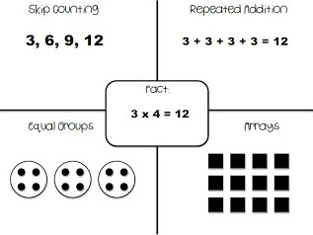

Slide 15
How to help your child…
Reading
There is a recommended(**) reading list on the class page on the website.

