Slide 1
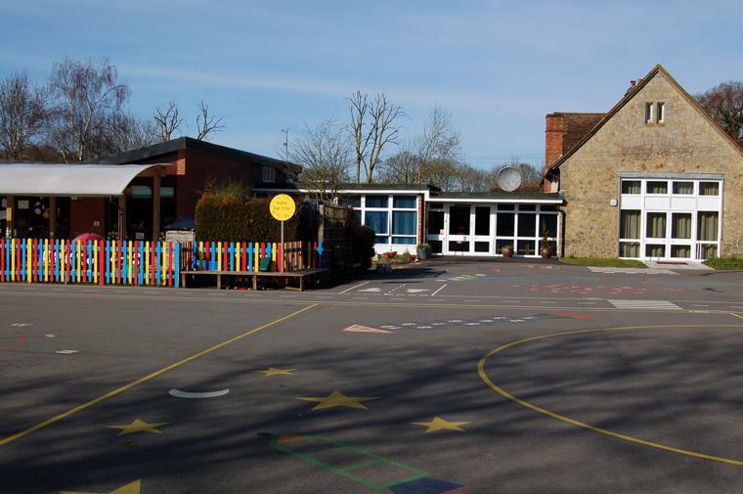
Back To School
Information Evening
Welcome to a new academic year!
Wednesday 11th September 2019

Slide 2
Routine
Please try to be punctual, playground gates open at 8:40 am. An adult will be on duty until the whistle blows at 8:50 am.
Remember children are not allowed to use the tyre park, ride scooters or bikes on the playground or play ball games.
This is due to younger children being present. We do not want anyone to get hurt.
If you need to make an appointment with your child’s Teacher, we would be happy to meet with you after school.
Mornings are very busy, however the Office Staff will always be pleased to pass any urgent messages to us.

Slide 3
Year One
As you are aware Year One children are either in Canterbury Class or Chichester Class.
Please be assured that ALL the children are taught the same Year One objectives when ready.
The Year One children spend four afternoons a week (an hour each afternoon) learning Phonics together. This will help to ensure continuity of friendships and the identity of Year One (as well as every playtime, lunchtime and assembly).

Slide 4
School uniform –EVERYTHING named. This helps to make children independent when changing for P.E.
Named water bottle everyday (regardless of season).
No juice only water!
Please ensure reading record, reading book and maths target book are kept in book bag. Any key words or sounds to be kept in book bags.
Library books are changed on Fridays.

Slide 5
Homework (Reading and Spelling)
Ideally please try to read everyday with your child. This really makes such a difference to your child’s learning!
In Canterbury Class children are given two books each week (changed on Mondays). Miss Herbert is more than happy for children to change their book more frequently, but they are encouraged to do this independently. It would really benefit the children if parents reminded them too. Everyday in Chichester Class children are reminded to change their reading books as and when needed.
Please sign the Reading Record each time your child reads even if you do not wish to make a comment.
Reading is a vital part of the curriculum. We read with your children everyday. Throughout the week your child will participate class stories, Phonics, Guided Reading, Topic work, Independent Reading and one to one reading. We aim to comment in your child’s Reading Record at least once a week.
Spellings are stuck in the back of the Reading Records every week for you to practise with your child at home. Spelling tests: Class 2 – Thursdays / Fridays Class 1 – Fridays.

Slide 6
Homework (Mathematics) Each child will be given a Math’s Target Book with individual targets for them to practise at home. We welcome any comments by parents regarding their child’s learning. On a regular basis we will check if your child has met their target. When the target is achieved 2 merit points and a sticker will be awarded. Then the next target will be set.

