Slide 1
Phonics Workshop
October 2019
24th February 2020

Slide 2
In school, we follow the Letters and Sounds programme. Letters and Sounds is a phonics resource published by the Department for Education and Skills which consists of six phases. We also use adapted Jolly Phonics actions alongside Letters and Sounds.

Slide 3
Terminology
Phoneme - The smallest unit of sound in a word.
Graphemes – graphical representation
of a sound/ phoneme
for some phonemes, this could be more than one letter. e.g. t, ai, igh
Segmenting -Hearing individual phonemes within a word.
E.g. crash has 4 phonemes c – r – a – sh
Blending - merging phonemes together to pronounce a word. Taught before shown letters – oral.
Let’s watch:Jolly phonics songs
https://vimeo.com/106231366
How to say the sound correctly – Pure sounds
https://www.youtube.com/watch?v=VQgizwwvqNk&safe=true
How to Fred/Robot talk
https://www.youtube.com/watch?v=dEzfpod5w_Q&safe=true

Slide 4
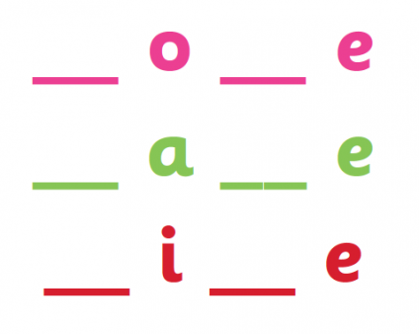
Terminology continued
Digraph -2 letters making one phoneme
Trigraph-3 letters making one phoneme
A consonant digraph contains two consonants next to each other, but they make a single sound. e.g. sh, ck, th, ll
A vowel digraph - contains at least one vowel but the two letters still make a single sound e.g. ai ee ar oy
A Split digraph – When a digraph is split by a consonant it becomes a split digraph – home ,name, time…..

Slide 5
Phase 1
There are 7 aspects with 3 strands.
A1 – Environmental
A2 – Instrumental sounds
A3 – Body Percussion
A4 – Rhythm and rhyme
A5 – Alliteration
A6 – Voice sounds
A7 – Oral blending and segmenting.

Slide 6
Phase 2
Set 1: s, a, t, p
Set 2: i, n, m, d
Set 3: g, o, c, k
Set 4: ck, e, u, r
Set 5: h, b, f, ff, l, ll, ss

Slide 7
Phase 3
Set 6: j, v, w, x
Set 7: y, z, zz, qu
Consonant digraphs: ch, sh, th, ng
Vowel digraphs: ai, ee, igh, oa, oo, ar, or, ur, ow, oi, ear, air, ure, er

Slide 8
Phase 4
This phase consolidates all the children have learnt in the previous phases.

Slide 9
Phase 5
Children will be taught new graphemes and alternative pronunciations for these graphemes.
Vowel digraphs: ay, ou, ie, ea, oy, ir, ue, aw, ew, oe, au
Split digraphs: a_e, e_e, i_e, o_e, u_e

Slide 10
Phase 6
The focus is on learning spelling rules for suffixes.
-s -es -ing -ed
-er -est -y -en
-ful -ly -ment -ness

Slide 11
Segmenting
Breaking down words for spelling.
cat
c a t

Slide 12
Segmenting
Queen
qu ee n

Slide 13
Blending
Building words from phonemes to read.
c a t
cat

Slide 14
Blending
Qu ee n
queen

Slide 15
What does a Phonics lesson look like?
Revisit/review | Flashcards to practice phonemes learnt so far.
Teach | Teach new phoneme air
Practice | Buried treasure Air, zair, fair, hair, lair, pair, vair, sair, thair
Apply | Read captions: The goat had a long beard. The quack was right in his ear.

Slide 16
Resources
http://www.phonicsplay.co.uk

Slide 17
Year 1 Phonics Test

Slide 18
~Important things to remember
Oral blending comes before they write and see letter sounds.
Display jolly phonics action posters in correct order.
- Have adapted Jolly Phonics sound mats for use when writing and as an aid for recalling the sounds.
- A set of Jolly Phonics flashcards of sounds for using in games.
Children need to ‘bump into’ their new sounds in their classroom. They need to come back into their classroom with a task or display to put up.

Slide 19
Useful websites
www.letters-and-sounds.com - Free resources for Letters and Sounds phonics
Jolly phonics songs
https://vimeo.com/106231366
How to say the sound correctly – Pure sounds
https://www.youtube.com/watch?v=VQgizwwvqNk&safe=true
How to Fred/Robot talk
https://www.youtube.com/watch?v=dEzfpod5w_Q&safe=true

