Slide 1
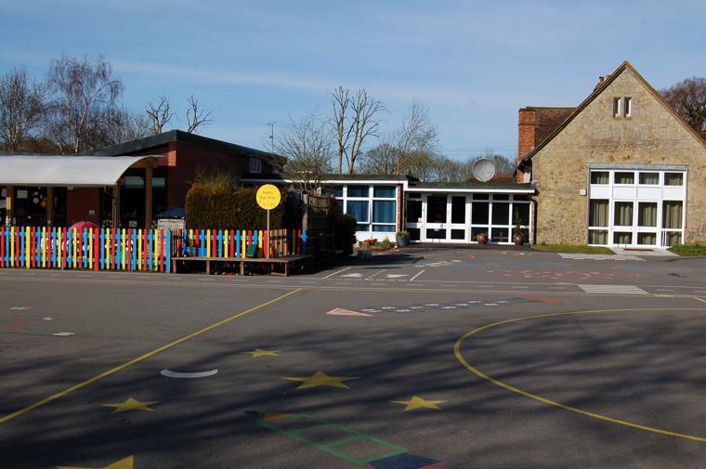
Meet the Teachers!
A caring Christian, community, where we love, learn and aim for excellence.
Thursday 8th September 2016

Slide 2
Routine
Please be punctual, playground gates open at 8:40 am. An adult will be on duty until the whistle blows at 8:50 am.
Remember children are not allowed to:
Use the tyre park.
Ride scooters or bikes on the playground.
Play ball games.
This is due to younger children being present. We do not want anyone to get hurt.
If you need to make an appointment with your child’s Teacher, we would be happy to meet with you after school on Wednesday. Please use the yellow booklets in the school entrance to make an appointment between 3:30 to 4:30pm. Mornings are very busy, however the Office Staff will always be pleased to pass any urgent messages to us.

Slide 3
School uniform –EVERYTHING named. This helps to make children independent when changing for P.E.
Named water bottle everyday (regardless of season).
Please ensure reading records and book, wallet, maths target sheet are kept in book bag. Any key words or sounds to be kept in wallet.
Library books are changed on Fridays.

Slide 4
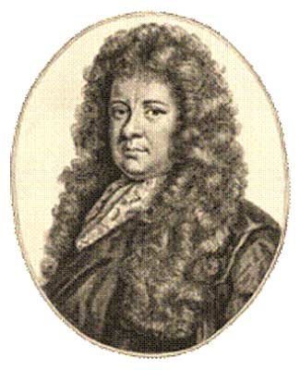
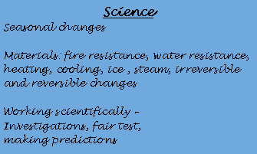
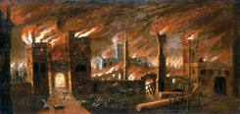
English
Diary Writing – Samuel Pepys
Factual Writing—All about me and my family
Information Texts—The Great Fire of London ,
Antarctica
Alliteration Poetry
Story Writing: Danny and the Great White Bear
by Anne Cottringer
Play Scripts
Comprehension
Newspaper Reports
Year 1 & 2
Autumn Term 2016
FIRE & ICE
Mathematics
Mental mathematics and home target cards
Problem solving
Number sequences and number bonds
Multiplication &
division facts
Money
Capacity, length and weight
Time
Shape
Religious Education &
Personal ,Social ,Health &
Citizen Education
Fire as a symbol in all faiths
Rama and Sita
The Holy Spirit
Advent
Christmas
Christingle and Candlemas
Feelings and relationships
Friendships
Wisdom
Physical Education
Physical Literacy
Football (invasion games)
Dance

Slide 5
Homework (Reading and Spelling)
Ideally please try to read everyday with your child. This really makes such a difference to your child’s learning!
Everyday each class is reminded to change their reading books as and when needed. We encourage them to do this independently and it would really benefit the children if parents reminded them too.
Please sign the Reading Record each time you read and add a comment if you wish.
Reading is a vital part of the curriculum. We read with your children everyday. Throughout the week your child will participate class stories, Phonics, Guided Reading, Topic work, Independent Reading and one to one reading.
We aim to comment in your child’s Reading Record at least once a week.
Spellings are stuck in the back of the Reading Records every week for you to practise with your child at home. Your child’s Teacher will advise you of the date of the spelling test.

Slide 6
Homework (Mathematics) Each child will be given a Maths Target Card with individual targets for them to practise at home. We would welcome any comments by parents regarding their child’s learning. On a regular basis we will check if your child has met their target. When the target is achieved 2 merit points and a sticker will be awarded. Then the next target will be set.

